Slide 1
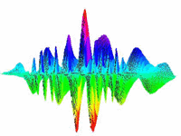
Time-Frequency Analysis
Ram Bilas Pachori
Discipline of Electrical Engineering
Indian Institute of Technology Indore

Slide 2
Overview
Transform
Fourier Transform (FT)
Short Time Fourier Transform (STFT)
Continuous Wavelet Transform (CWT)
Discrete Wavelet Transform (DWT)
Wigner-Ville Distribution (WVD)
Hilbert-Huang Transform (HHT)
Conclusion

Slide 3
Transform
Transform: A mathematical operation that takes a function or sequence (one domain) and maps it into another one (other domain)
We need signal transforms because
The transform provides hidden information about the original function or signal
The transform helps to solve a differential equation
The transform may provide data compression and storage may require less memory
Some operations may be easier to apply in the transform domain (Example: Convolution operation in LTI systems).

Slide 4
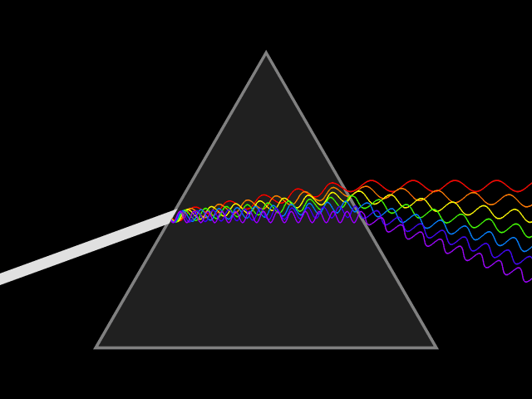
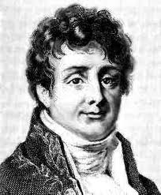
Fourier Representation (December, 21, 1807)
Jean B. Joseph Fourier
(1768-1830)
Prism
“An arbitrary function, continuous or with discontinuities, defined in a finite interval by an arbitrarily capricious graph can always be expressed as a sum of sinusoids”
J.B.J. Fourier

Slide 5
Fourier’s work
1807, J.B. Fourier:
All periodic functions can be expressed as a weighted sum of trigonometric functions
Denied publication by Lagrange, Legendre and Laplace
1822: Fourier’s work was finally published
…
…
1965, Cooley & Tukey: Fast Fourier Transform
143 years

Slide 6
Fourier Transform
Complicated signal representation in terms of simple signals
(Basis functions: sinusoidal functions)
Fourier transform is like a bridge between time domain and frequency domain
Analysis and synthesis equations for Fourier transform are as:

Slide 7
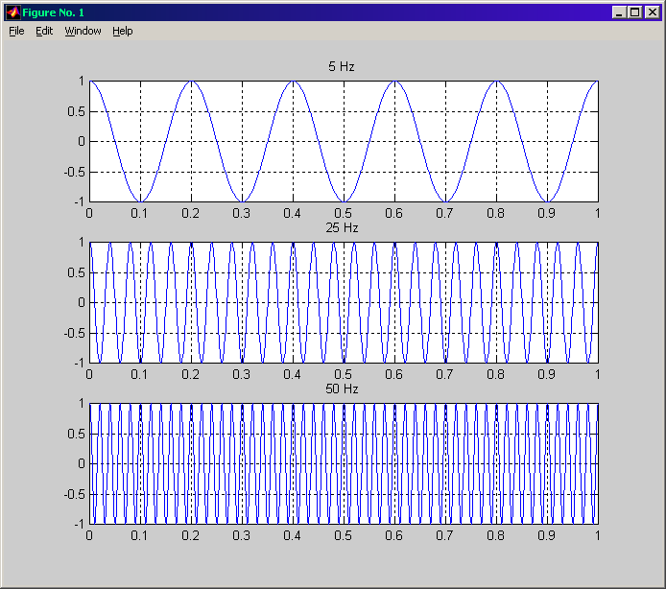
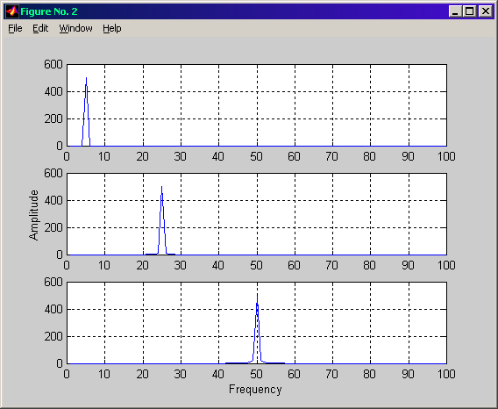
Example
Time domain
Frequency domain

Slide 8
Shortcomings of the Fourier Transform
Fourier transform identifies all frequency components present in the signal, however it does not provide any information regarding the time localization of these frequency components
Stationary signals consist of frequency components that do not change in time
all spectral components exist at all times (time information is not required)
Fourier transform works fine for stationary signals
Non-stationary signals consist of time varying frequency components
Fourier transform is not suitable for such type of signals
For such signals, we need to determine time localization of frequency components

Slide 9
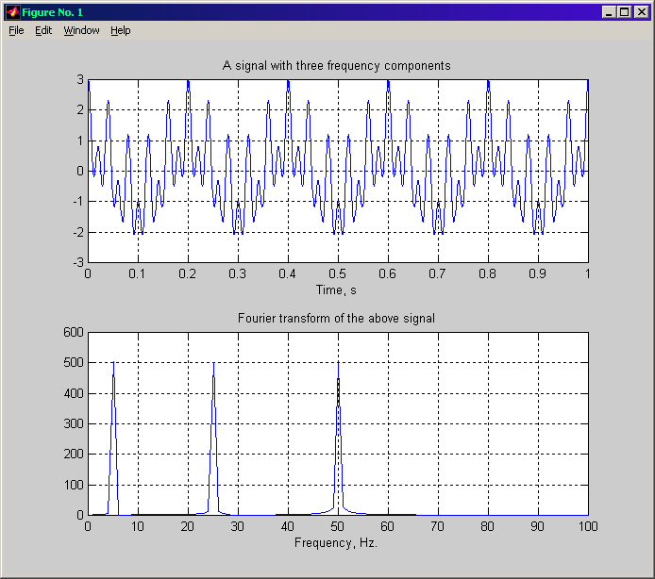
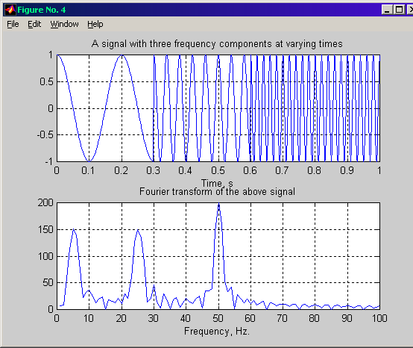
Example
Stationary signal
Frequency domain
Nonstationary signal

Slide 10
Motivation for Time-Frequency Representation
Sinusoids /exponentials basis functions in Fourier transform (global analysis):
Stretch into infinity in time, therefore has no time localization
Instantaneous in frequency, therefore has perfect frequency localization
Need a time dependent frequency representation (or time-frequency representation) for nonstationary signals.

Slide 11
Short Time Fourier Transform (STFT)
Time
parameter
Frequency
parameter
Signal to
be analyzed
FT Kernel
(basis function)
STFT of signal x(t):
Computed for each
window centered at t=t’
Windowing
function
Windowing function
centered at t=t’

Slide 12
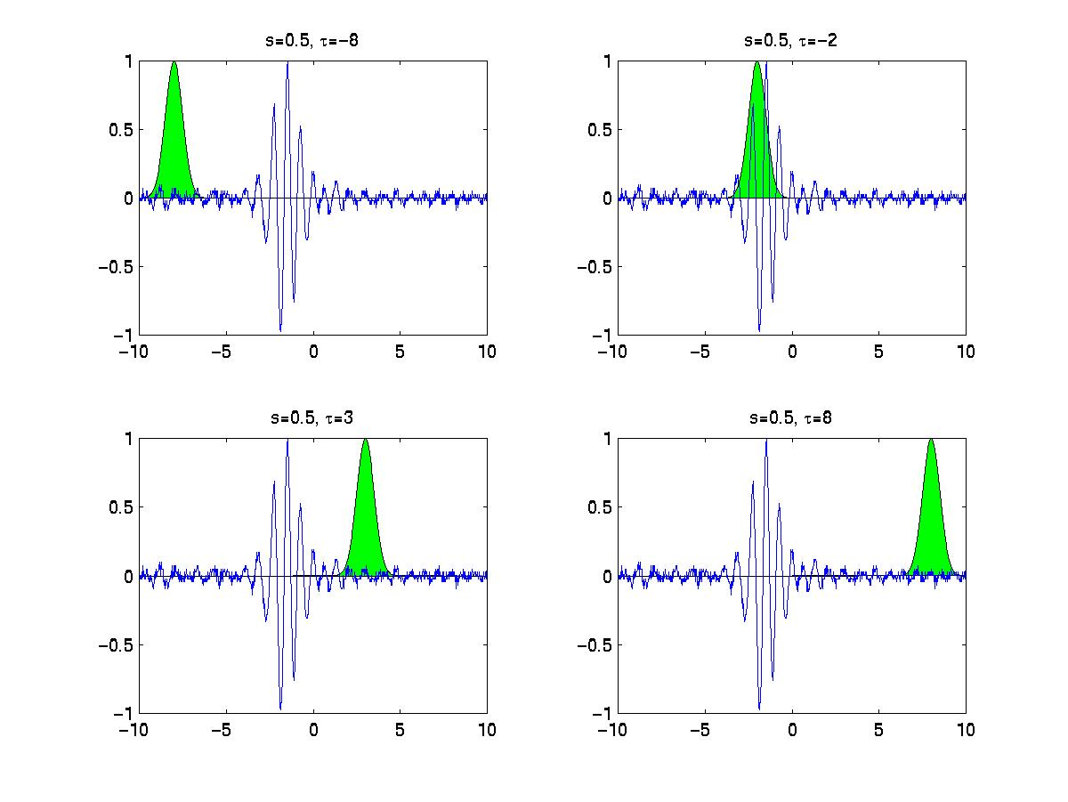
Example
t’=-8 t’=-2
t’=4 t’=8

Slide 13
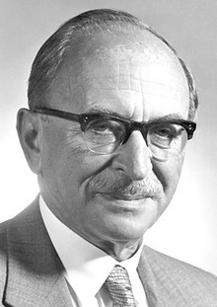
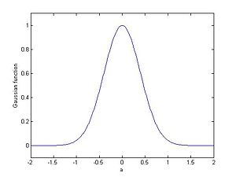
Spectrogram:
STFT is a complex quantity
STFT is a linear operator
Spectrogram: squared magnitude of STFT
Spectrogram is nonlinear operator
D. Gabor (1946)
Gabor transform
Gaussian window

Slide 14
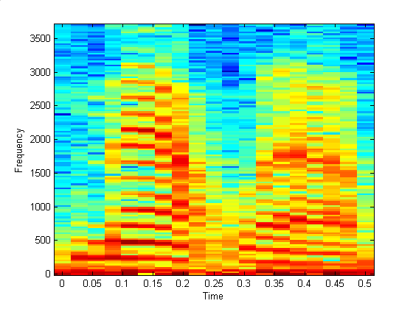
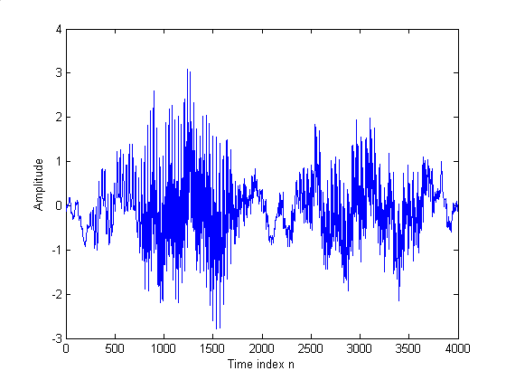
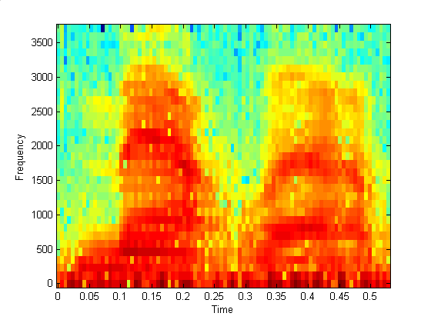
Example: Speech signal (MATLAB)
Narrowband spectrogram
(large window, 256 samples)
Wideband spectrogram
(Short window, 64 samples)

Slide 15
Matlab code
clc;
clear all;
close all;
load mtlb
n=1:4001;
plot(n-1,mtlb)
xlabel('Time index n');
ylabel('Amplitude');
figure;
nfft=input('Type in the window length=');
ovlap=input('Type in the desired overlap=');
specgram(mtlb,nfft,7418,hamming(nfft),ovlap)

Slide 16
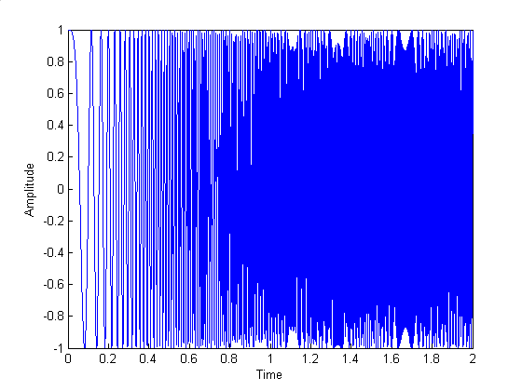
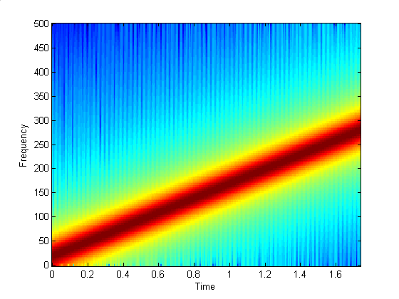
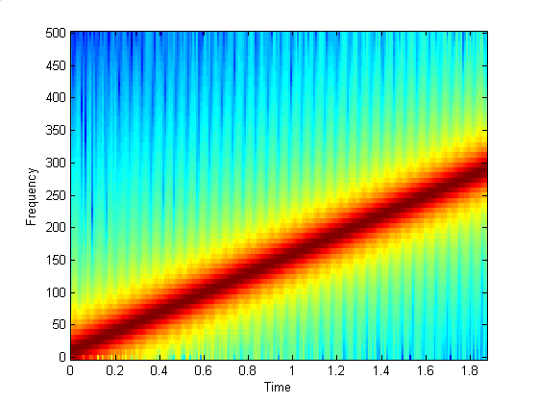
Example: Linear chirp signal
Narrowband spectrogram
(large window, 256 samples)
Wideband spectrogram
(Short window, 128 samples)

Slide 17
Matlab Code
clc;
clear all;
close all;
t=0:0.001:2;
y=chirp(t,0,1,150);
specgram(y,128,1E3,128,120);

Slide 18
Shortcoming of STFT
STFT provides the time information by computing a different Fourier transforms of the truncated signal using a sliding window function
How to select type and size of the window? problem!
Wide analysis window provides poor time resolution and good frequency resolution
Narrow analysis window provides good time resolution and poor frequency resolution

Slide 19
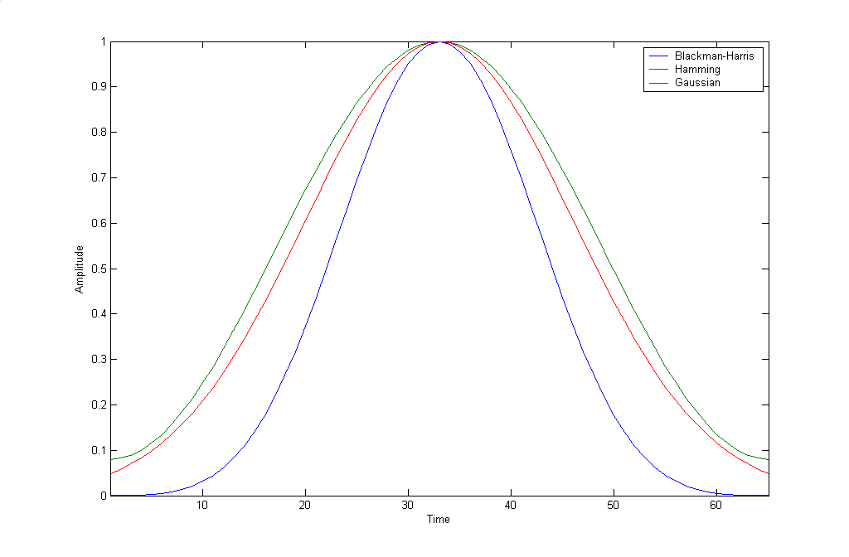
Window Functions
Bartlett window
Blackman window
Bohman window
Chebyschev window
Hamming window
Hanning window
Kaiser window
Rectangular window
Triangular window
Gaussian window
Matlab:
w=window(@hamming,N);

Slide 20
Heisenberg Principle
Time resolution
How well two spikes in time can be separated from each other in the transform domain
Frequency resolution
How well two spectral components can be separated from each other in the transform domain
Both time and frequency resolutions cannot be high!

Slide 21
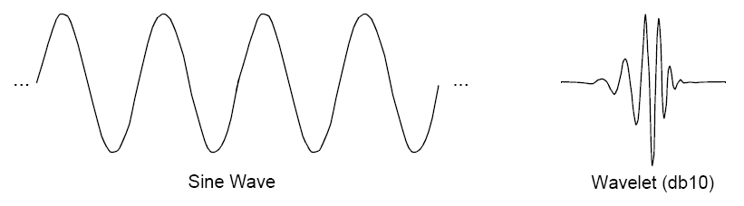

Wavelet
A wavelet is a waveform of limited duration that has an average value of zero.
Comparison of wavelets with sine waves, which are the basis functions of Fourier analysis.
Sinusoids do not have limited duration — they extend from minus to plus infinity. And where sinusoids are smooth and periodic, wavelets tend to be irregular and a periodic.
Some foods are better handled with a fork than a spoon

Slide 22
Continuous Wavelet Transform (CWT)
Overcomes the fixed resolution problem of the STFT by using a variable length window
Analysis windows of different lengths are used for different frequencies:
Narrow window analysis of high frequencies provides good time resolution and poor frequency resolution
Wide window analysis of low frequencies provides good frequency resolution and poor time resolution
This works well, if the signal to be analyzed mainly consists of slowly varying characteristics with occasional short high frequency bursts

Slide 23
CWT (Contd…)
Scale parameter, measure of frequency
A normalization
constant
Signal to be analyzed
Translation parameter, measure of time
Continuous wavelet transform of the signal x(t) using the analysis wavelet ψ(.)
The mother wavelet. All kernels are obtained by translating (shifting) and/or scaling the mother wavelet
Scale = 1/frequency

Slide 24
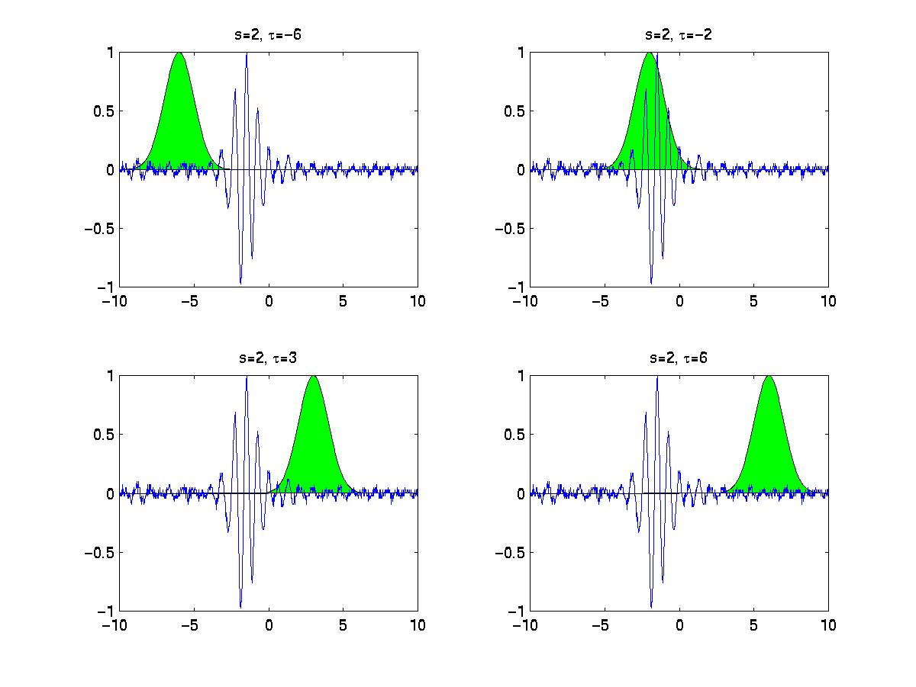
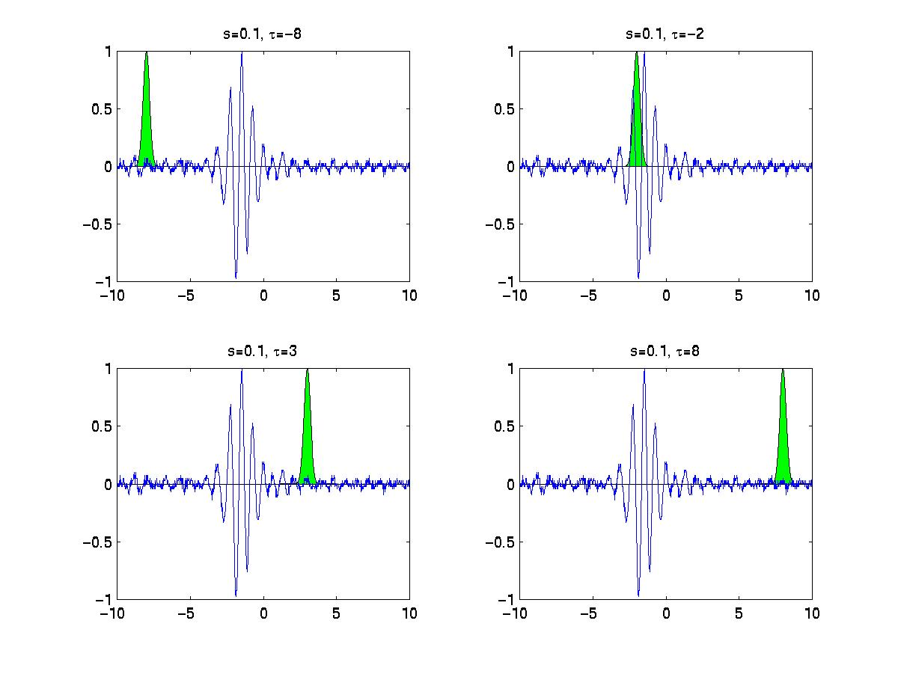
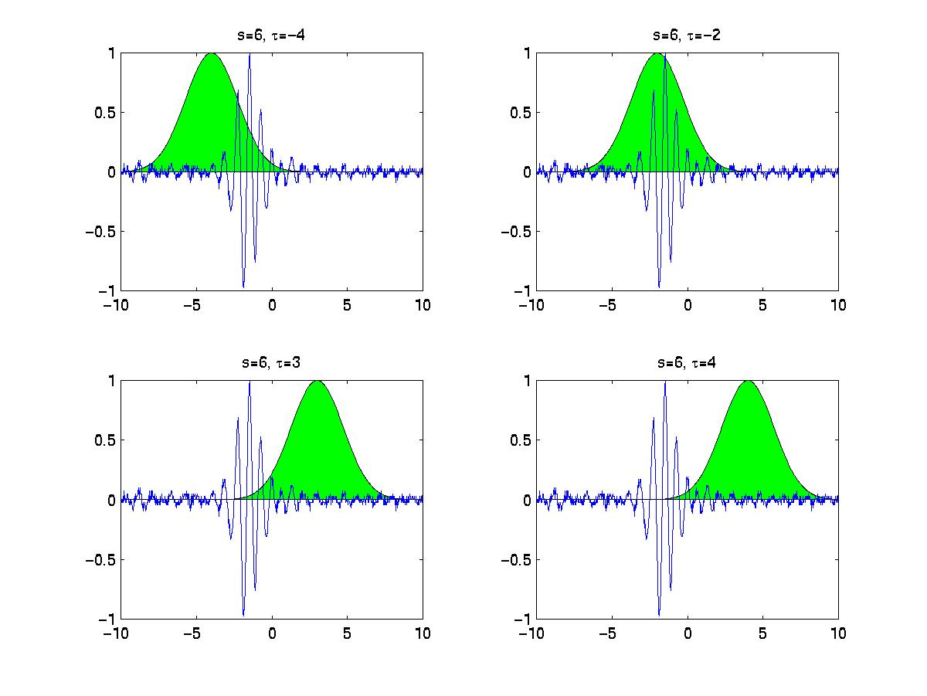
Example
Low frequency (large scale)
High frequency (small scale)

Slide 25
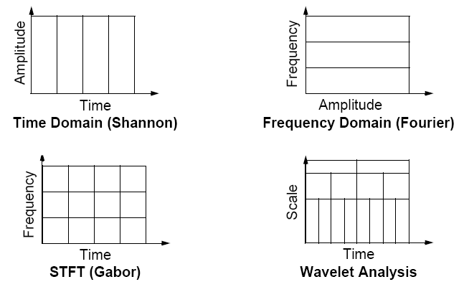
Multiresolution Property

Slide 26
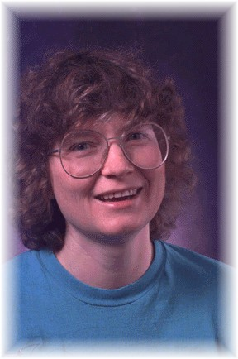
History
Late 1970s, Morlet’s (geophysical engineer) : Windows to be generated from dilation / compression of prototype small, oscillatory signals ➔ wavelets
Criticism for lack of mathematical proof!!!
Early 1980s, Grossman (theoretical physicist): Formalize the transform and devise the inverse transformation ➔ First wavelet transform !
1984-1985, Yeves Meyer: Develop orthogonal wavelet basis functions with better time and frequency localization.
Ingrid Daubechies:
Discretization of time and scale parameters of the wavelet transform
Wavelet frames, 1986
Orthonormal bases of compactly supported wavelets (Daubechies wavelets), 1988

Slide 27


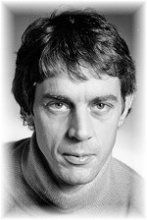
History
Stephane Mallat:
Multiresolution analysis w/ Meyer, 1986
Ph.D. dissertation, 1988
Discrete wavelet transform
Cascade algorithm for computing DWT
Martin Vetterli & Jelena Kovacevic
Wavelets and filter banks, 1986
Perfect reconstruction of signals using FIR filter banks, 1988
Sub-band coding
Multidimensional filter banks, 1992

Slide 28
Scalogram
Wavelet transform may be a complex quantity
Wavelet transform is a linear operator
Scalogram: squared magnitude of wavelet transform
Scalogram is a nonlinear operator
Cross Terms: when frequencies are very closer

Slide 29
Scalogram in Matlab
Coefficients = CWT(S,SCALES,'wname',plot)
plot
signal
scale range
name of the wavelet

Slide 30
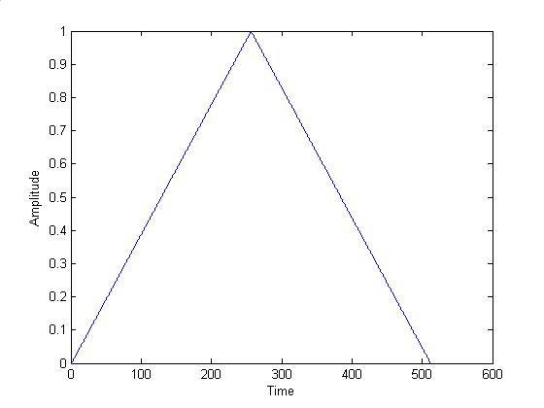
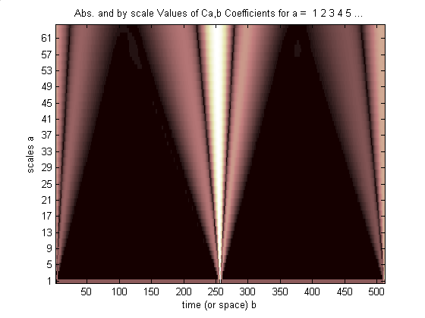
Example 1
Time domain
Time-scale domain

Slide 31
Matlab code
clc;
clear all;
close all;
t = linspace(-1,1,512);
s = 1-abs(t);
c = cwt(s,1:64,'sym4','abslvl');

Slide 32
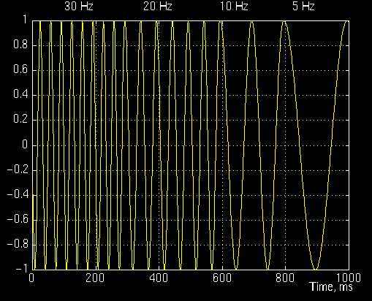
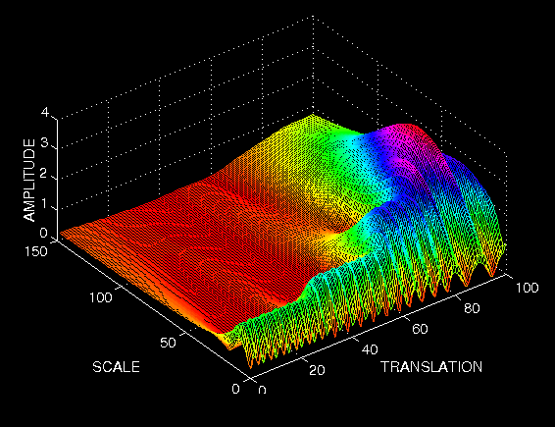
Example 2
Time domain
Time-scale domain

Slide 33
Discrete Wavelet Transform (DWT)
In order to compute CWT by computers, we need to discretize the continuous time-scale plane
The CWT representation is a very redundant representation
Discretize the continuous time-scale plane on a dyadic (octave) grid: dyadic wavelet transform

Slide 34
DWT Implementation
x[n]
x[n]
~
G
G
2
2
+
~
2
~
2
H
H
G
2
2
G
+
~
2
2
H
H
Decomposition
Reconstruction
G
Half band high pass filter
Half band low pass filter
2
Down-sampling
Up-sampling
H
2
Two-level DWT decomposition

Slide 35
DWT Implementation (Contd…)
Length: 512
B: 0 ~ π
|H(jw)|
g[n]
h[n]
w
Length: 256
B: π/2 ~ π Hz
2
2
Length: 256
B: 0 ~ π/2 Hz
-π/2
π/2
a₁
|G(jw)|
d₁: Level 1 DWT
Coeff.
g[n]
h[n]
Length: 128
B: 0 ~ π /4 Hz
w
Length: 128
B: π/4 ~ π/2 Hz
2
2
-π
-π/2
π/2
π
a₂
d₂: Level 2 DWT
Coeff.
g[n]
h[n]
Length: 64
B: π/8 ~ π/4 Hz
2
2
Length: 64
B: 0 ~ π/8 Hz
d₃: Level 3 DWT
Coeff.
…a₃….
Level 3 approximation
Coefficients

Slide 36
DWT in Matlab
[cA, cD]= dwt(S,'wname’)
approximation
signal
name of the wavelet
detail

Slide 37
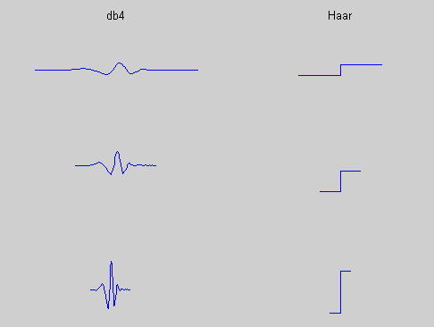
Commonly used wavelets

Slide 38
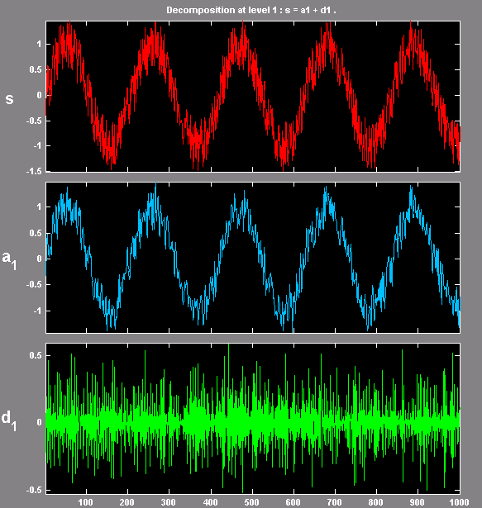
DWT decomposition: Approximation and details
Low frequency- Approximation
High frequency-Details
Decomposition can be
performed iteratively

Slide 39
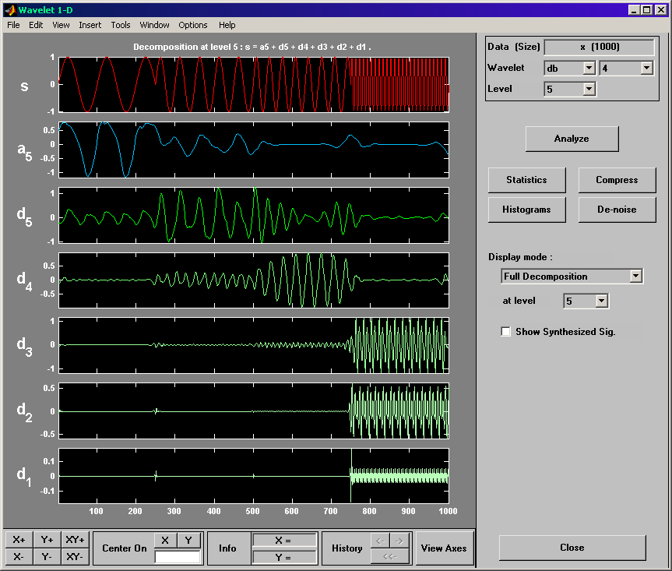
DWT Implementation (wavemenu in MATLAB)
Choose wavelet
and number
of levels
Load signal
s=a₅+d₅+…+d₁
Hit Analyze
button
Approx. coef.
at level 5
Level 1 coeff.
Highest freq.
(Wavedemo_signal)

Slide 40
Applications of Wavelets
Compression
De-noising
Feature extraction
Discontinuity detection
Data analysis
Biological data
Financial data

Slide 41
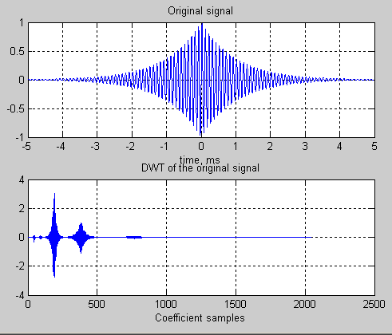
Example 1: Compression
DWT is commonly used for compression
Most of the DWT coefficients are insignificant, can be zeroed-out!

Slide 42
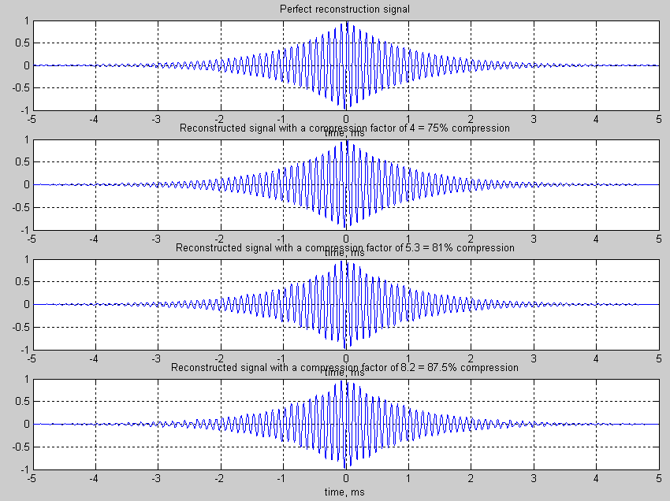
Example 1: Compression (Contd…)

Slide 43
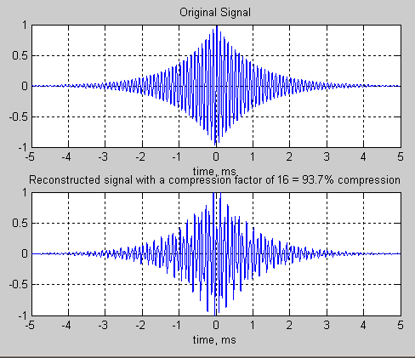
Example 1: Compression (Contd…)

Slide 44
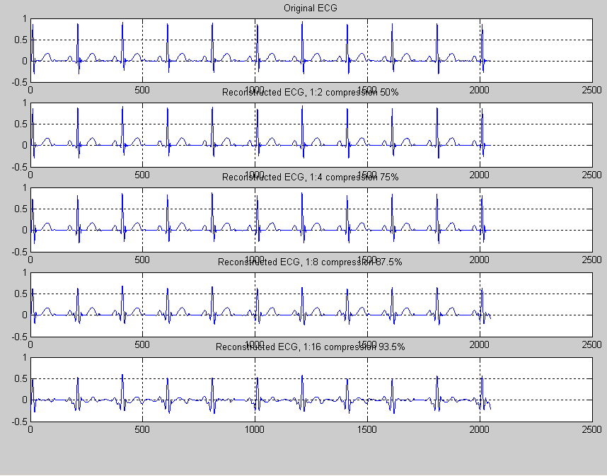
Example 2: Compression of ECG Signal

Slide 45
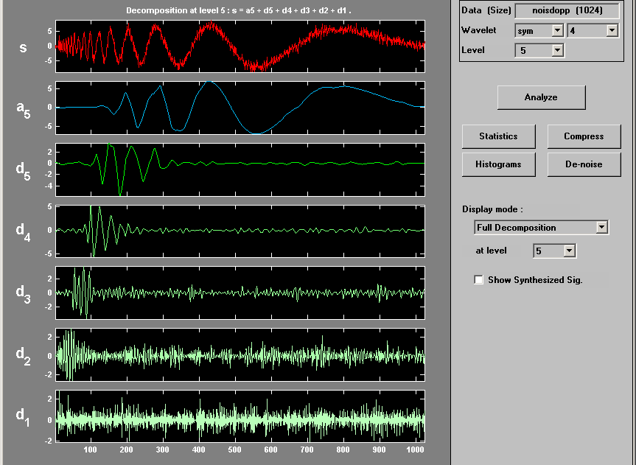
Example 3: Denoising
(Noisy Doppler)

Slide 46
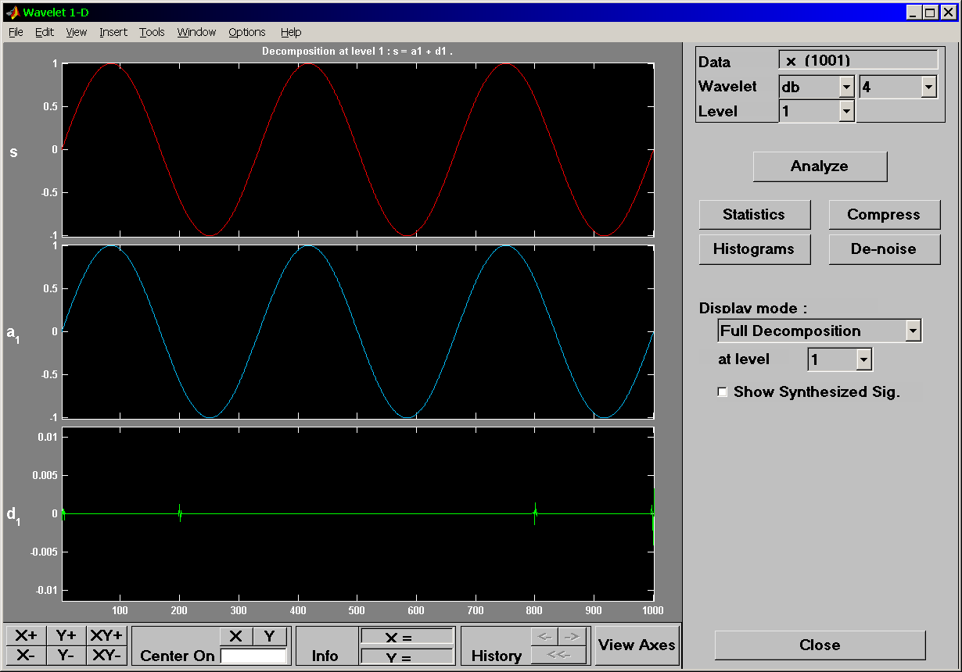
Example 4: Discontinuity Detection using DWT
(microdisc.mat)

Slide 47
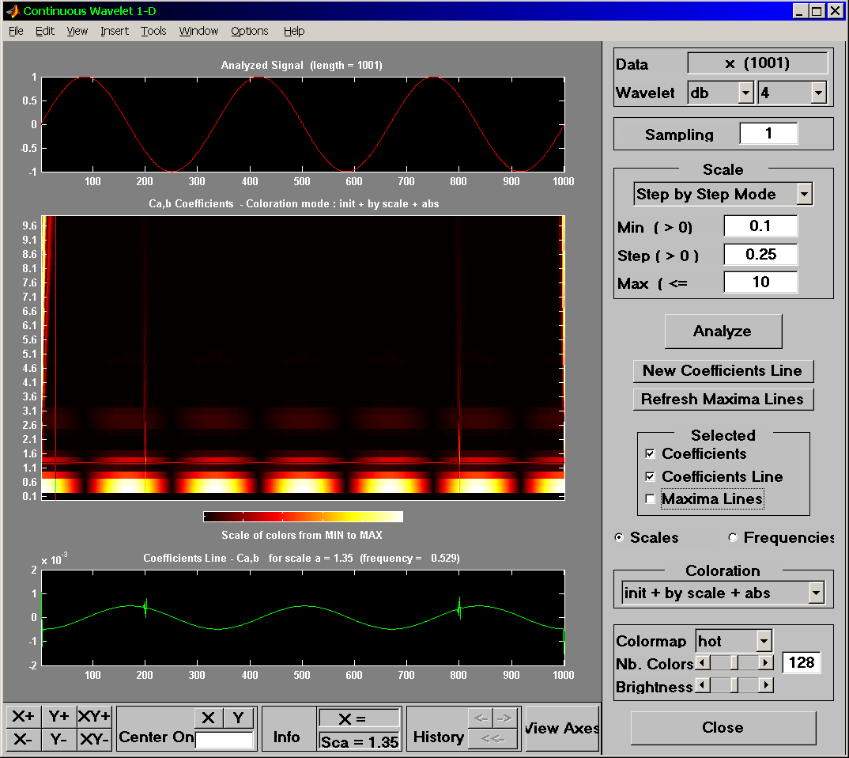
Example 5: Discontinuity Detection using CWT
(microdiSsc.mat)

Slide 48
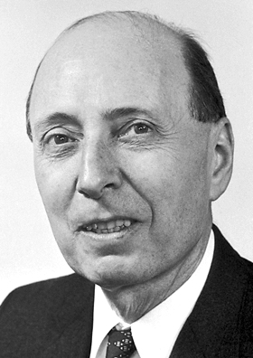
Wigner-Ville Distribution (WVD)
He received a Nobel prize in Physics in 1963
He was from Physics background.
Ville was from field of Communications.
E. Wigner

Slide 49
Wigner-Ville Distribution (WVD)
The WVD is a quadratic time–frequency distribution with good resolution in both time and frequency domains.
The WVD of a signal is defined in the time-domain as:
The WVD of a signal is defined in the frequency-domain as:

Slide 50
Cross Terms in WVD
The WVD of a multicomponent signal
The WVD of a signal is given by
The method based on WVD introduces the cross terms in the time-frequency domain. Problem!

Slide 51
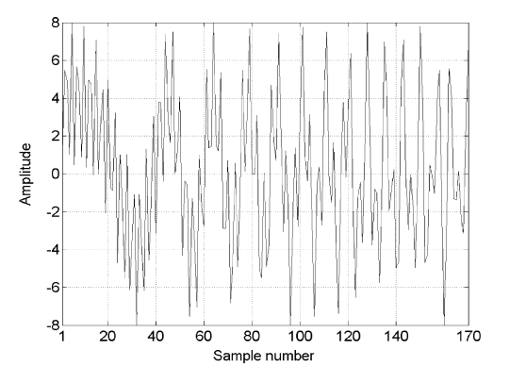
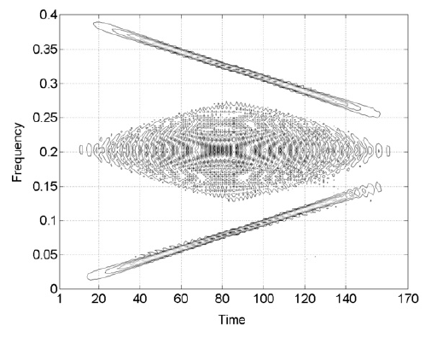
Example 1
Time domain (sum of two
linear chirp signals with
positive-nagative chirp rates)
Time-frequency domain

Slide 52
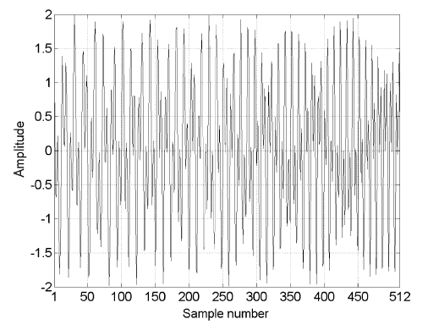
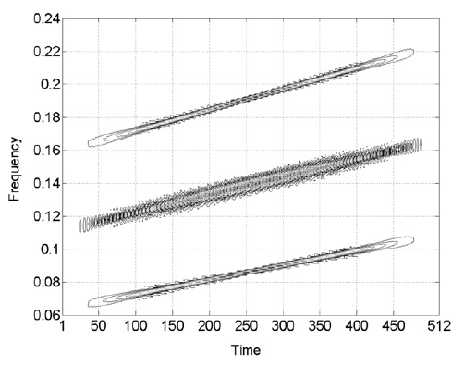
Example 2
Time domain (sum of two
linear chirp signals with
positive-positive chirp rates)
Time-frequency domain

Slide 53
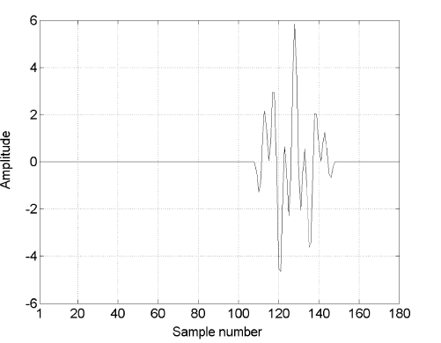
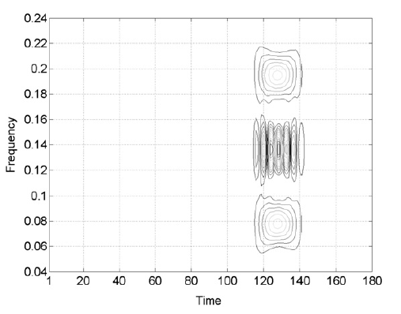
Example 3
Time domain (sum of two
separated bands of
frequency components)
Time-frequency domain

Slide 54
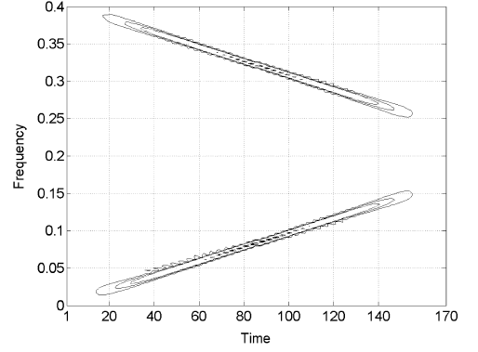
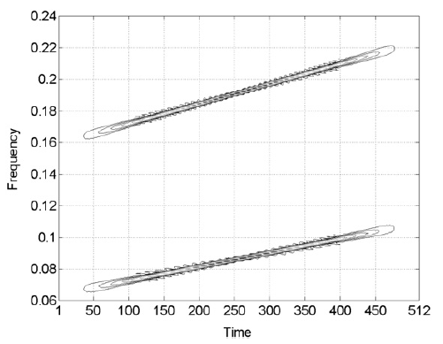
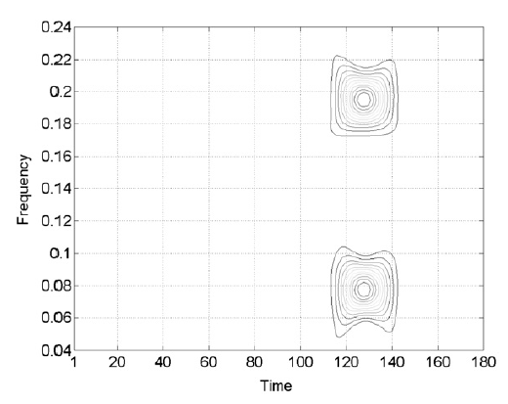
Methods for Reduction of Cross Terms
Kernel design
Wavelet decomposition
Perfect reconstruction filter bank
Fourier-Bessel decomposition
Image processing
Matlab codes: Time-frequency toolbox
http://tftb.nongnu.org/
Cross terms free time-frequency
domain

Slide 55
Hilbert-Huang Transform (HHT)
The HHT is especially suited for analyzing non-linear and non-stationary signals
It has two parts: Empirical mode decomposition (EMD) and Hilbert spectral analysis (HSA)
EMD method provides a set of narrow-band signals known as intrinsic mode functions (IMFs)
The HSA is used to compute the amplitude envelope and instantaneous frequency of the individual IMF

Slide 56
EMD Method
The EMD method is an adaptive, and data dependent method
The EMD method does not require any condition about the stationary and linearity of the signal
The aim of the EMD method is to decompose the nonlinear and nonstationary signal x(t) into a sum of intrinsic mode functions
Each IMF satisfies two basic conditions:
(i) The complete data set, the number of extrema and the number of zero crossings must be the same or differ at most by one
(ii) The mean value of the envelope defined by the local maxima and local minima is zero

Slide 57
EMD Method (Contd…)
Step 1: Compute the upper and lower envelopes of the signal x(t) and their mean value m₁(t)
Step 2: Compute h₁(t)=x(t)-m₁(t)
Step 3: Check if h₁(t) satisfies the IMF conditions.
Step 4: If not, use h₂(t)= h₁(t)-m₂(t) to obtain new h, where m₂(t) is computed from h₁(t) as in step 1.
Step 5: Continue until an h_{k}(t) satisfies the IMF conditions. When done, c₁(t)=h_{k}(t) is the first IMF.
Step 6: Consider the r(t)=x(t)-c₁(t) as the new signal, continue from Step 1 to get the other higher IMFs, upto c_{N}(t).
Process is continued until the residue becomes a monotonous function

Slide 58
Working Principle of EMD Method: Example
Matlab codes are available at http://perso.ens-lyon.fr/patrick.flandrin/emd.html.

Slide 59
(Contd…)

Slide 60
(Contd…)

Slide 61
(Contd…)

Slide 62
(Contd…)

Slide 63
(Contd…)

Slide 64
(Contd…)

Slide 65
(Contd…)

Slide 66
(Contd…)

Slide 67
(Contd…)

Slide 68
(Contd…)

Slide 69
(Contd…)

Slide 70
(Contd…)

Slide 71
(Contd…)

Slide 72
(Contd…)

Slide 73
(Contd…)

Slide 74
(Contd…)

Slide 75
(Contd…)

Slide 76
(Contd…)

Slide 77
(Contd…)

Slide 78
(Contd…)

Slide 79
(Contd…)

Slide 80
(Contd…)

Slide 81
(Contd…)

Slide 82
(Contd…)

Slide 83
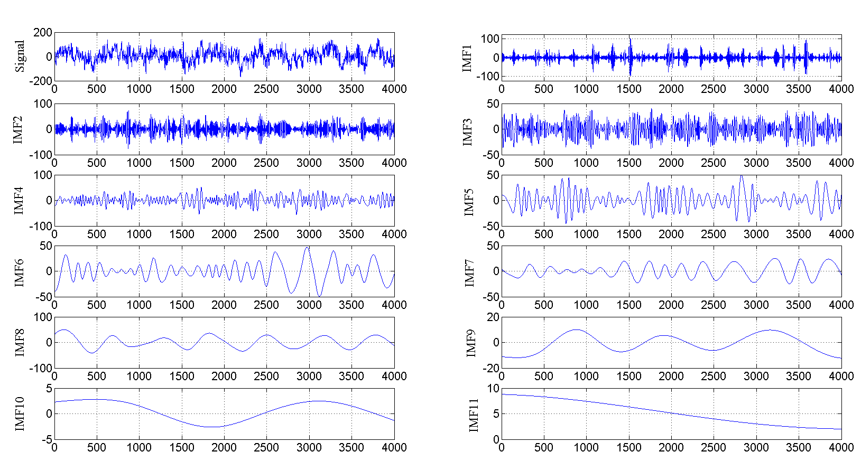
EMD of healthy EEG signal

Slide 84
Hilbert Spectral Analysis (HSA)
Amplitude envelope and instantaneous frequency of IMFs are estimated using HSA technique
After decomposition, the actual signal can be represented as a linear combination of narrow-band IMFs (or AM-FM) signals

Slide 85
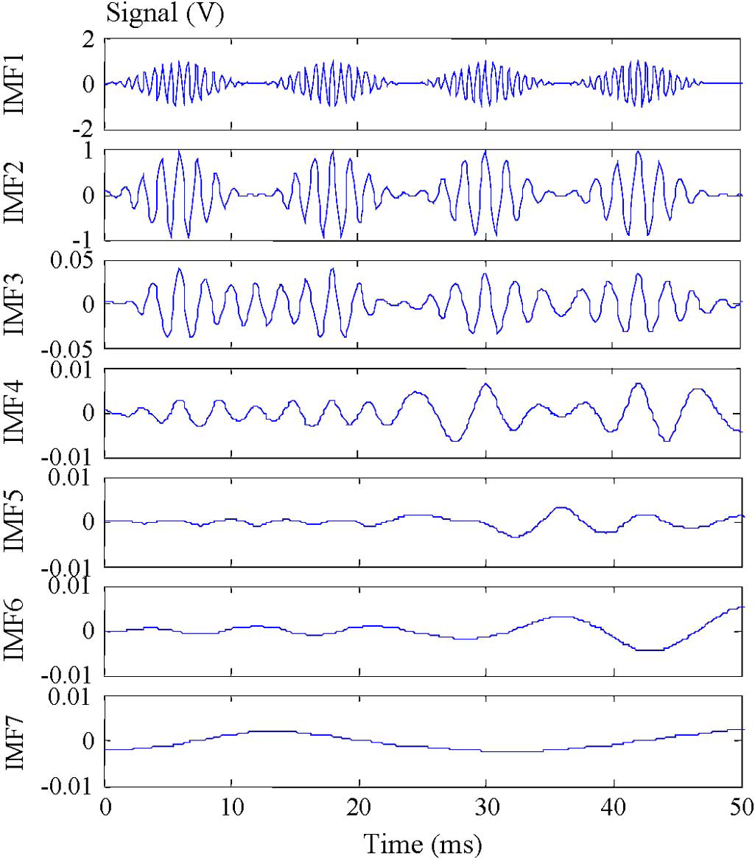


Example 1: Synthetic signal

Slide 86

HHT of synthetic signal

Slide 87
Conclusion
Time-Frequency representation is a general representation of frequency representation (similarly nonstationary signal is a general representation of stationary signal)
Problems in time-frequency representations:
-Short time Fourier transform (STFT): Selection of type and size of window function
-Wavelet transform (WT): Selection of mother wavelet
-Wigner-Ville distribution (WVD): Presence of cross terms
-Hilbert-Huang transform (HHT): No mathematical representation
Time-frequency analysis is an active area of research

Slide 88
References
http://users.rowan.edu/~polikar/wavelets/wttutorial.htm
R.B. Pachori and P. Sircar, “A new technique to reduce cross terms in Wigner distribution” Digital Signal Processing, vol. 17, no. 2, pp. 466-474, March 2007.
R. Yan and R.X. Gao, “ Hilbert-Huang transform based vibration signal analysis for machine health monitoring, IEEE Transactions on Instrumentation and Measurement, vol. 55, no. 6, pp. 2320-2329, December 2006.
N.E. Huang, et al., “The empirical mode decomposition and Hilbert spectrum for nonlinear and non-stationary time series analysis”, Proc. Roy. Soc. London A, vol. 454, pp. 903–995, 1998.

Slide 89
Thank you very much

